Slide 1
Chapter 11 EC Strategy and Implementation: Ethical Issues

Slide 2
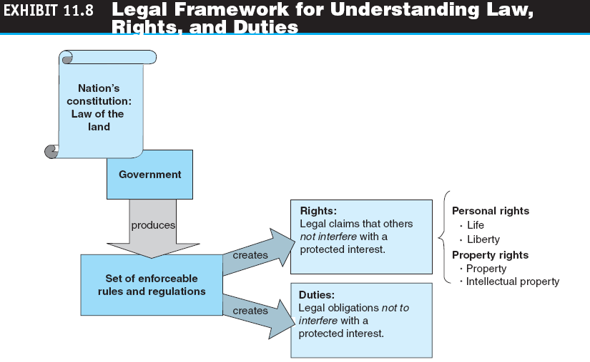

Slide 3
INTELLECTUAL PROPERTY AND OTHER REGULATORY ISSUES
LAWS ARE SUBJECT TO INTERPRETATION
PERSONAL AND PROPERTY RIGHTS
civil litigation
An adversarial proceeding in which a party (the plaintiff) sues another party (the defendant) to get compensation for a wrong committed by the defendant.

Slide 4
INTELLECTUAL PROPERTY AND OTHER REGULATORY ISSUES
regulatory compliance
Systems or departments in an organization whose job is to ensure that personnel are aware of and take steps to comply with relevant laws, standards, policies, and regulations.
compliance data
All data belonging or pertaining to an enterprise included in the law, which can be used for the purpose of implementing or validating compliance.

Slide 5
INTELLECTUAL PROPERTY AND OTHER REGULATORY ISSUES
intellectual property
Creations of the mind, such as inventions, literary and artistic works, and symbols, names, images, and designs, used in commerce.
copyright
An exclusive right of the author or creator of a book, movie, musical composition, or other artistic property to print, copy, sell, license, distribute, transform to another medium, translate, record, perform, or otherwise use.
infringement
Use of the work without permission or contracting for payment of a royalty.

Slide 6
INTELLECTUAL PROPERTY AND OTHER REGULATORY ISSUES
digital rights management (DRM)
An umbrella term for any of several arrangements that allow a vendor of content in electronic form to control the material and restrict its usage.
fair use
The use of copyrighted material for noncommercial
purposes.

Slide 7
INTELLECTUAL PROPERTY AND OTHER REGULATORY ISSUES
patent
A document that grants the holder exclusive rights to an invention for a fixed number of years.
trademark
A symbol used by businesses to identify their goods and services; government registration of the trademark confers exclusive legal right to its use.

Slide 8
INTELLECTUAL PROPERTY AND OTHER REGULATORY ISSUES
- Taobao selling fake products
- Newspaper or magazines selling fake products
Can consumers sue them?
11-7
Notes:
7

Slide 9
ETHICS IN E-COMMERCE
ethics
The branch of philosophy that deals with what is considered to be right and wrong.
privacy
The right to be left alone and free of unreasonable personal intrusions.
ETHICAL PRINCIPALS AND GUIDELINES
Example: Who Owns User-Generated Content at Facebook?

Slide 10
ETHICS IN E-COMMERCE
business ethics
A form of applied ethics that examines ethical principles and moral or ethical problems that arise in a business environment.
EC ETHICAL ISSUES
Nonwork-Related Use of the Internet
Codes of Ethics

Slide 11
PRIVACY, VIOLATION AND PROTECTION, AND THE CONFLICT WITH FREE SPEECH
PRIVACY RIGHTS AND PROTECTION
opt-out
Business practice that gives consumers the opportunity to refuse sharing information about themselves.
opt-in
Agreement that requires computer users to take specific steps to allow the collection of personal information.

Slide 12
PRIVACY, VIOLATION AND PROTECTION, AND THE CONFLICT WITH FREE SPEECH
FREE SPEECH ONLINE VERSUS PRIVACY PROTECTION
Free Speech Online Versus Child Protection Debate
Children’s Internet Protection Act (CIPA)
U.S. law that mandates the use of filtering technologies in schools and libraries that receive certain types of federal funding.

Slide 13
PRIVACY, VIOLATION AND PROTECTION, AND THE CONFLICT WITH FREE SPEECH
THE PRICE OF PROTECTING AN INDIVIDUAL’S PRIVACY
Example: Sheriff Sues Craigslist to Curb Prostitution
HOW INFORMATION ABOUT INDIVIDUALS IS COLLECTED
Web Site Registration
Cookies
RFID’s Threat to Privacy
Privacy of Employees
darknets
Private online community that is only open to those who belong to it.

Slide 14
PRIVACY, VIOLATION AND PROTECTION, AND THE CONFLICT WITH FREE SPEECH
PRIVACY ISSUES IN WEB 2.0 TOOLS AND SOCIAL NETWORKS
Presence, Location, and Privacy
Free Speech via Wikis and Social Networks
PRIVACY PROTECTION USING ETHICAL PRINCIPLES
Platform for Privacy Preferences Project (P3P)
A protocol allowing Web sites to declare their intended use of information they collect about browsing users.

Slide 15
PRIVACY, VIOLATION AND PROTECTION, AND THE CONFLICT WITH FREE SPEECH
USA PATRIOT Act
Uniting and Strengthening America by Providing Appropriate Tools to Intercept and Obstruct Terrorism Act passed in October 2001, in the aftermath of the September 11 terrorist attacks. Its intent is to give law enforcement agencies broader range in their efforts to protect the public.

Slide 16
EC AND GREEN COMPUTING
green computing
The study and practice of ecofriendly computing resources; is now a key concern of businesses in all industries—not just environmental organizations.
green IT
Green IT begins with manufacturers producing environmentally friendly products and encouraging IT departments to consider more friendly options like virtualization, power management, and proper recycling habits.

Slide 17
EC AND GREEN COMPUTING
How to Operate Greener Businesses, Data Centers, and Supply Chains
Global Green Regulations
Electronic Product Environmental Assessment Tool (EPEAT)
A searchable database of computer hardware that meets a strict set of environmental criteria.

Slide 18
THE FUTURE OF ELECTRONIC COMMERCE
INTEGRATING THE MARKETPLACE WITH THE MARKETSPACE
SOCIAL NETWORKS
FUTURE TRENDS
Security concern
Lack of Net neutrality
Copyright complaints
Choppy connectivity

Slide 19
MANAGERIAL ISSUES
What is the strategic value of EC to the organization?
Who determines EC strategy?
What are the benefits and risks of EC?
What metrics should we use?
How do we measure the value of EC investment?

Slide 20
MANAGERIAL ISSUES
How can we go global?
Can we learn to love smallness?
What legal and ethical issues should be of major concern to an EC enterprise?
What are the most critical ethical issues?
How shall we approach EC green computing?

